Slide 1



Dr B R Ambedkar University,Srikakulam
College of Engineering
Dept.of Computer Science and Engineering,
MCA FINAL YEAR
PROJECT REVIEW-I
TITLE:Currency Recognition System For Visually Impaired
Presented by:
Lingampalli Krupa Charan Pal
Roll No: 2251926013
under the guidance of
Ronanki Sridhar Sir
(Head Of Department)

Slide 2
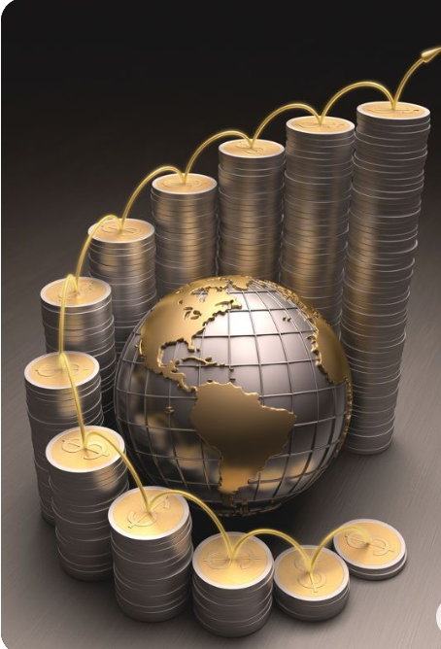
Content
01
ABSTRACT
02
INTRODUCTION
03
OVERVIEW
04
CHALLENGES
05
REQUIREMENTS
06
SYSTEM DESIGN
07
CONCLUSION

Slide 3


ABSTRACT
It is relatively simple for a normal human to lead a life, but when it comes to visually impaired persons, leading a life is not that easy;
they get obstacles in each and every aspect of their life. Among them, interpreting and understanding every banknote is the major difficulty, especially when it comes to paper currency.
Since currency plays such a vital role in our day to day lives and is crucial for every possible business and personal transaction, real-time detection and recognition of banknotes become a necessity for blind or visually impaired people.
For that purpose, we are going to propose a real-time object detection system to help visually impaired people in their daily transactions.

Slide 4


INTRODUCTION
Visually Impaired are those people who have vision impairment or vision loss. Problems faced by the visually impaired in performing daily activities are in great numbers.
They also face a lot of difficulties in monetary transactions. They are unable to recognize the paper currencies due to similarity of paper texture and size between different categories. This system helps visually impaired patients to recognize and detect money.
We are going to develop a system that scans the currency note and helps the blind person to identify it, as the system voices it out with the audio of different languages like English, Telugu for that respective currency note. Despite the widespread usage of ATMs, Credit-Debit Cards, and other digital modes of payment like Google Pay, Paytm, and Phone Pay, money is still widely used for most daily transactions due to its convenience.

Slide 5


OVERVIEW
Recognition of banknotes becomes essential for blind or visually impaired persons because currency is so important to our daily lives and is required for every business and personal transaction. In order to assist those who are visually impaired in their daily activities, we will present a currency note recognition system.
Manager

Slide 6
CHALLENGES
Visually impaired people find it difficult to detect and count different denominations of currency.
If the user supplies incorrect data, then abnormality is detected as the system could not classify features precisely
It tends to be difficult to access and implement currency detection.
Automatic recognition systems must achieve high accuracy.
Manager

Slide 7

SYSTEM REQUIREMENTS
Software requirements
● VS CODE
● IDLE (Python 3.9 64 bit)
● Scanner
Hardware requirements
● Processor : i5 (or Above)
● RAM : 32 GB (or 16 GB of 1600 MHz DDR3 RAM)
● Storage : 300 GB
Manager

Slide 8
SYSTEM DESIGN
System design is the process of defining the elements of a system such as the architecture, modules and components, the different interfaces of those components and the data that goes through that system. It is meant to satisfy specific needs and requirements of a business or organization through the engineering of a coherent and well-running system.
Systems design mainly concentrates on defining the architecture, components, modules, interfaces, and data for a system to satisfy specified requirements. Systems design could be seen as the application of systems theory to product development.

Slide 9
CONCLUSION
We presented a system of currency recognition for the people who are visually challenged. Our system is made to scan the Indian currency and voice out an audio in English. Our system helps them to scan any currency note and based on audio provided they can recognize the value of each banknote.
The methods we used will work well on noisy images which are shot with a cell phone. The recommended approach also offers advantages like high performance and simplicity. compared to the present method, more accurate.
Manager

Slide 10

THANK YOU

